Slide 1


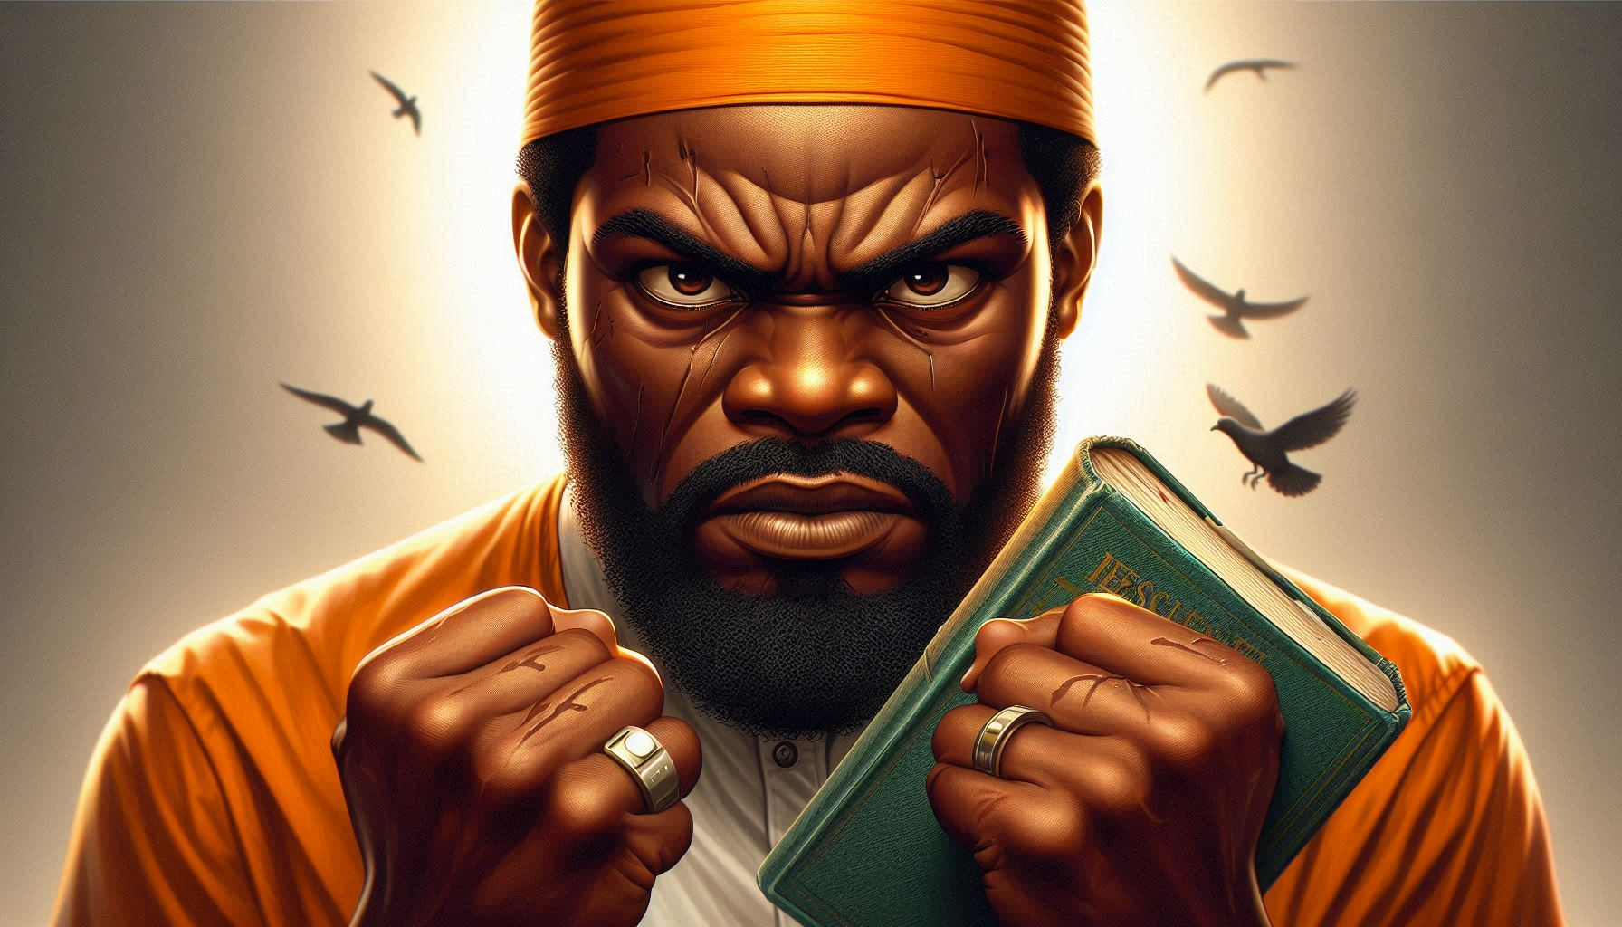
The Mature, Faithful,
Spirit Led Christian
Defers
His Anger
Proverbs 19:11
Notes:
Eddie Williams ~ May 25, 2025 (Eloy AM)
~ August 30, 2026 (Eloy AM)

Slide 2
Proverbs 19:11(KJV)
The discretion of a man deferreth his anger; and it is his glory to pass over a transgression.

Slide 3
You can be glorious today, for someone will surely offend you. With the discretion of God’s wisdom, you can defer your anger and ignore his or her transgression against you. You can turn the other cheek, pass over the provocation, and choose mercy over wrath.

Slide 4
But only those obeying Jesus Christ and taught by the Holy Spirit will ever do so.
Discretion is the ability to know the right action for any occasion. Deferring is putting off, delaying, or postponing something.

Slide 5
Godly discretion chooses to delay and postpone getting angry when someone offends you. It is the mark of a wise man, a gracious and gentle spirit. It is a mark of Christian maturity, for only wicked fools quickly strike back.

Slide 6
Most people, when offended by others, bristle with hostility, choose to be hurt, get indignant, bite back, and plot revenge. They have no discretion, for feelings rule their hearts. They do not know deferment, for they react first, then think about it later.

Slide 7
This is the mark of a proud and froward spirit (Pr 16:28; 28:25), contrary to wisdom and grace.
Anger is temporary insanity, and to give in to its hot and hasty demands will surely cause you to misjudge an offence and retaliate out of proportion (Pr 14:17).

Slide 8
Once an offence is turned into conflict and strife, then you have a war that is not easily ended (Pr 17:14; 18:19). Discretion is the wise choice to regain your sanity before judging an offence.

Slide 9
But only those obeying Jesus Christ and taught by the Holy Spirit will ever do so.
You should learn that anger not released will dissipate; it will soon evaporate. Often by the next day, you can hardly remember offences of the previous day.

Slide 10
But this benefit requires two things – you must defer your anger by not releasing it, and you must keep a spirit that rejoices to pass over offences. Learn to defer your anger, reader (Pr 14:29).

Slide 11
You must choose a spirit that glories in forgiving those who hurt you, by choosing the way of wisdom, peace, and love (Pr 17:9; I Cor 13:4-7; Jas 3:17). The spirit that glories in quick retaliation or retribution is from hell (Jas 3:14-16), and you should reject and despise it.

Slide 12
Man’s natural inclination prides itself in quickly spotting and righting personal wrongs, but this is wickedness. Choose mercy, peace, and love instead.
The transgressions here are personal offences against you.

Slide 13
This proverb is not teaching you to pass over, or compromise with, sins against God or rightful authority. Parental authority, civil government, and employers must still enforce rules. The offences here are the relatively minor transgressions of others that irritate and provoke you.

Slide 14
This is a wonderful proverb, one of the best. If practiced consistently, personal relationships would be perfect and human societies would be joyful and productive. This is true love and friendship. Marriages observing this rule will be glorious. Churches practicing this discretion will be happy and Spirit-filled.

Slide 15
If everyone overlooked personal offences and gloried in the opportunity to forgive, life could be wonderful.
But pride keeps a man from deferring anger. He must strike back in quick revenge to protect his imagined superiority and hurt feelings.

Slide 16
Desiring preeminence over others, he must protect his self-interests. Sullen faces appear, sharp words are spoken, criticisms are hurled without cause, and blows might even be thrown. This is a proud fool.

Slide 17
God’s wisdom does not change. Jesus taught this rule plainly in Matthew 5:38-48, where He called for offering another cheek to personal enemies. He said not to resist evil, when it is a personal offence against you. He said to do good to your personal enemies.

Slide 18
This is the way of godly peacemakers, and they become very good at it. They glory in forgiving, and they are glorious in the forgiveness they give enemies. They are the true sons of God.

Slide 19
Scriptural Examples and
Learnings

Slide 20
#1: Jesus on the cross asked God to forgive those who crucified Him
Luke 23:34 (KJV)
Then said Jesus, Father, forgive them; for they know not what they do. And they parted his raiment, and cast lots.

Slide 21
#2: Steven asked God to forgive those who were stoning him.
Acts 7:60 (KJV)
And he kneeled down, and cried with a loud voice, Lord, lay not this sin to their charge. And when he had said this, he fell asleep.

Slide 22
#3: Love covers a multitude of sins.
I Peter 4:8 (NASB)
Above all, keep fervent in your love for one another, because love covers a multitude of sins.

Slide 23
#4: The same way you forgive your church family God will forgive you.
Matthew 18:34-35 (NASB)
³⁴ "And his master, moved with anger, handed him over to the torturers until he would repay all that was owed him.

Slide 24
Matthew 18:34-35 (NASB)
³⁵ "My heavenly Father will also do the same to you, if each of you does not forgive his brother from your heart."

Slide 25
#5: If you have ought with your brother God said go to him and him alone not gossip and tell others
Matthew 18:15 (NASB)
Now if your brother sins, go and show him his fault in private; if he listens to you, you have gained your brother.

Slide 26
#6: Evil speech is the wisdom from the Devil.
James 3:13-18 (NASB)
¹³ Who among you is wise and understanding? Let him show by his good behavior his deeds in the gentleness of wisdom.

Slide 27
James 3:13-18 (NASB)
¹⁴ But if you have bitter jealousy and selfish ambition in your heart, do not be arrogant and so lie against the truth. ¹⁵ This wisdom is not that which comes down from above, but is earthly, natural, demonic.

Slide 28
James 3:13-18 (NASB)
¹⁶ For where jealousy and selfish ambition exist, there is disorder and every evil thing. ¹⁷ But the wisdom from above is first pure, then peace-loving, gentle, reasonable, full of mercy and good fruits, impartial, free of hypocrisy.

Slide 29
James 3:13-18 (NASB)
¹⁸ And the fruit of righteousness is sown in peace by those who make peace.

Slide 30
#7: Not overlooking trespasses will devour one another, The Church Christ died for.
Galatians 5:13-15 (NASB)
¹³ For you were called to freedom, brothers and sisters;

Slide 31
Galatians 5:13-15 (NASB)
only do not turn your freedom into an opportunity for the flesh, but serve one another through love. ¹⁴ For the whole Law is fulfilled in one word, in the statement,

Slide 32
Galatians 5:13-15 (NASB)
"YOU SHALL LOVE YOUR NEIGHBOR AS YOURSELF." ¹⁵ But if you bite and devour one another, take care that you are not consumed by one another.

Slide 33
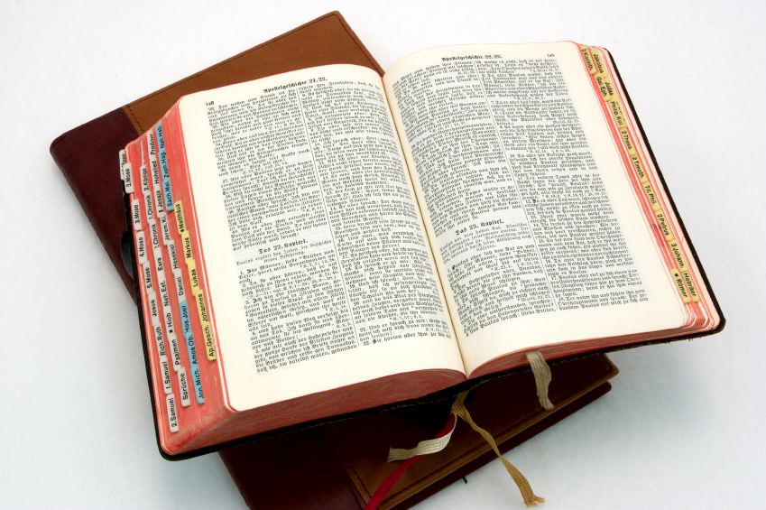
Hear: Romans 10:17
So then faith cometh by hearing, and hearing by the word of God.

Slide 34
Believe: Hebrews 11:6
But without faith it is impossible to please him: for he that cometh to God must believe that he is, and that he is a rewarder of them that diligently seek him.

Slide 35
Repent: Luke 13:3
I tell you, Nay: but, except ye repent, ye shall all likewise perish.

Slide 36
Confess: Matthew 10:32-33
32 Whosoever therefore shall confess me before men, him will I confess also before my Father which is in heaven.
33 But whosoever shall deny me before men, him will I also deny before my Father which is in heaven.

Slide 37
Baptize: Acts 22:16
And now why tarriest thou? arise, and be baptized, and wash away thy sins, calling on the name of the Lord.

